Slide 1
TexGen Workshop
Louise Brown

Slide 2
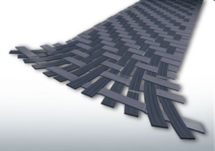
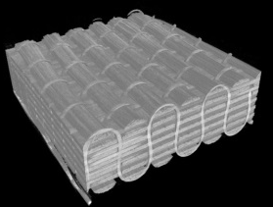
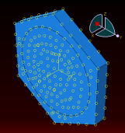
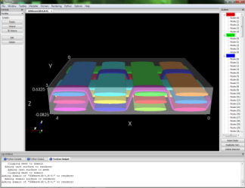
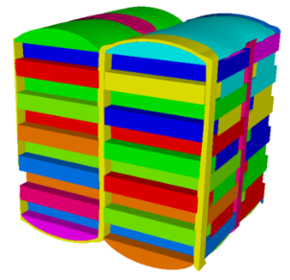
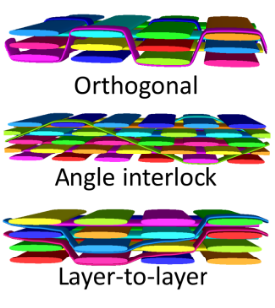
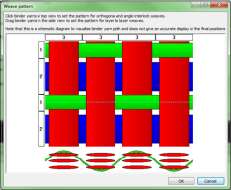

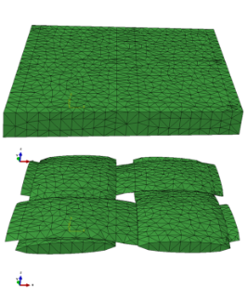
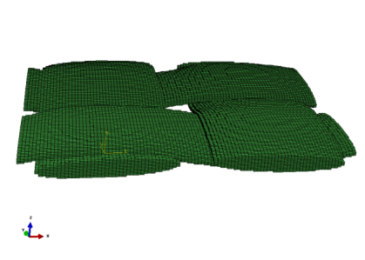
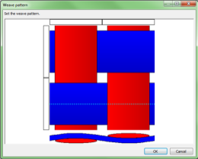
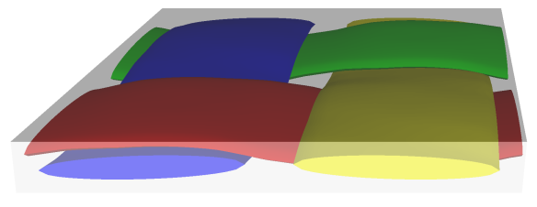
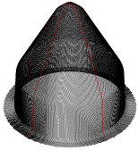

TexGen Geometric Textile Modelling Software
Fibre/Micro-Scale
Micro-scale FEA simulations or analytical methods determine yarn properties
Unit Cell/Meso-Scale
Generate textile geometry using TexGen GUI or script
3D wizard generates idealised 3D textiles
Refinement of orthogonal weave to simulate compaction
Automatically generate 2D and 2D sheared textiles
Generate mesh and input files for FEA or CFD to predict material properties
Composite material properties extracted from meso-scale predictions are used to model structural components
Component/Macro-Scale

Slide 3
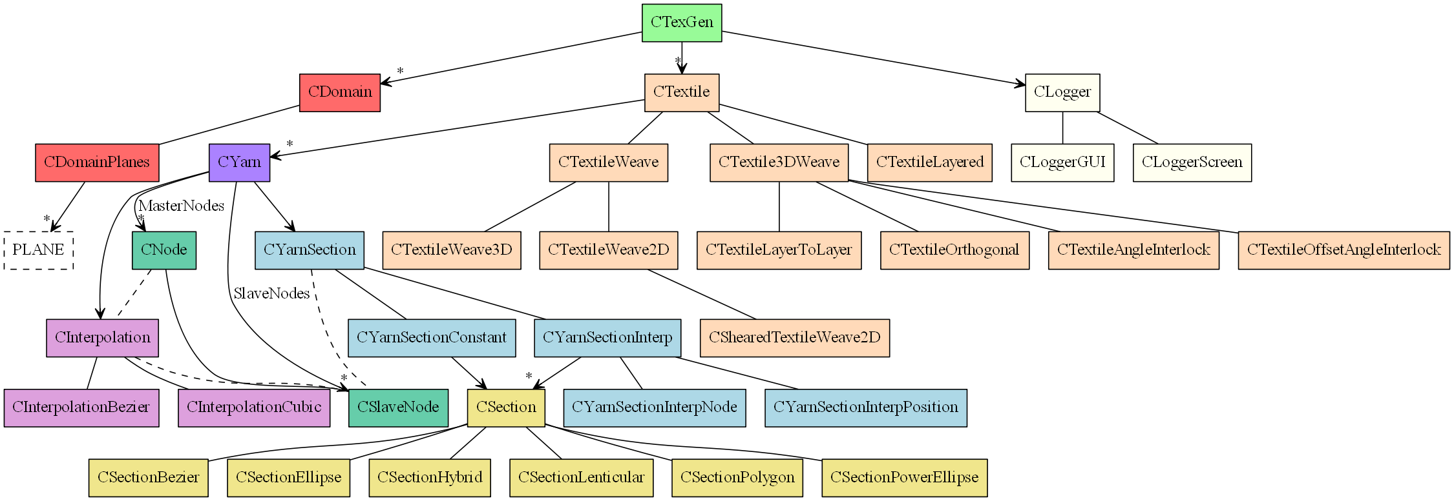
TexGen Class Heirarchy

Slide 4
Generating a Textile
1 - Create Textile
Steps combined and performed automatically in 2D and 3D wizards
Create yarn path
Assign sections
Select interpolation
Assign repeats
Assign fibre properties
2 - Add yarns
3 - Specify domain
Each step individually using either GUI, Python script or C++ API functions
4 - Output data

Slide 5
Create Textile
Each textile is created in a Ctextile object
GUI: Select Textiles -> Create Empty ( Step 1 )
Python:
Textile = CTextile()

Slide 6
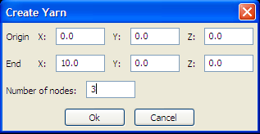
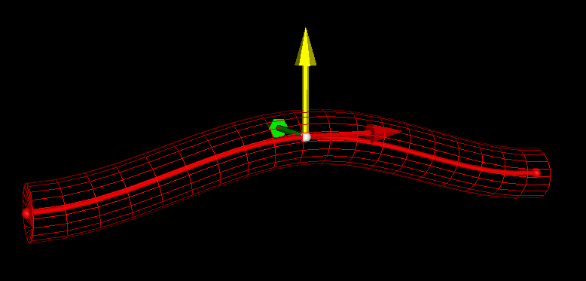
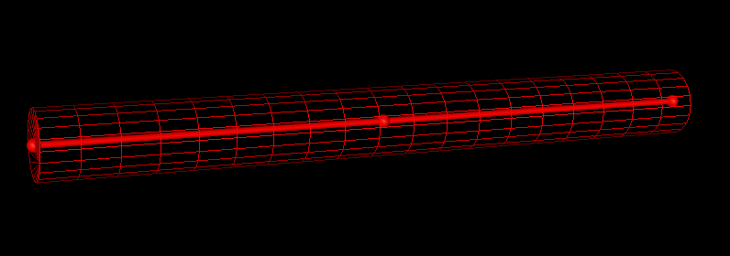
Create Yarns
Yarns are denotes by a set of Master Nodes
GUI: Select Modeller->Create Yarn ( Step 2 )
Python:
Yarn = CYarn()
Yarn.AddNode(CNode(XYZ(0,0,0)))
Yarn.AddNode(CNode(XYZ(5,0,1)))
Yarn.AddNode(CNode(XYZ(10,0,0)))

Slide 7
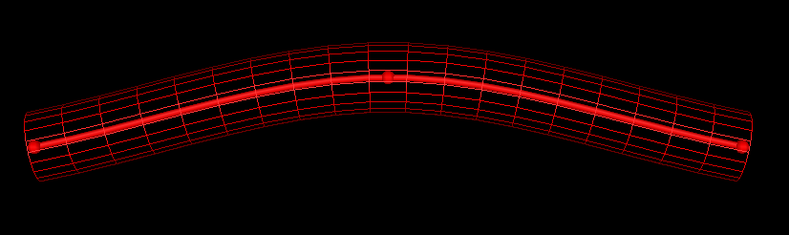
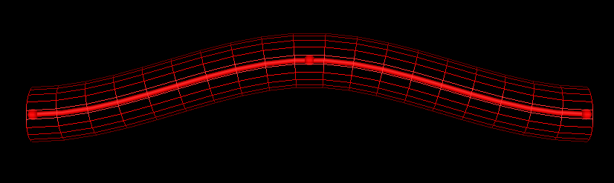
Interpolation Between Nodes
A path is generated between the master nodes by an interpolation function
GUI: Select Modeller -> Interpolation
Bezier spline
Natural cubic spline
Linear spline
Periodic – select to maintain continuity across yarn repeats
Python:
Yarn.AssignInterpolation(CInterpolationCubic())
Defaults to periodic, send False as parameter to CInterpolationCubic() for non-periodic interpolation

Slide 8
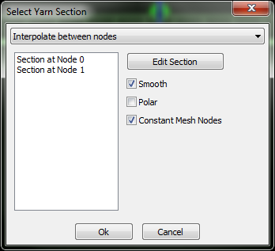
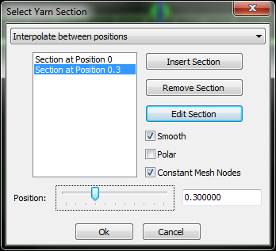
Yarn Cross-Sections - Interpolation
Yarn cross-sections are specified as 2D sections perpendicular to the yarn tangent
By default the cross-section is constant along the length of the yarn or an interpolation method can be chosen
GUI: Select Modeller -> Assign Section
Select interpolation
Constant
Interpolate between nodes
Interpolate between positions

Slide 9
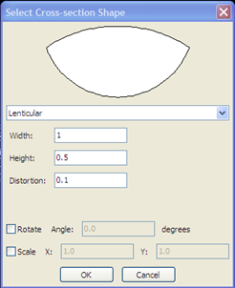
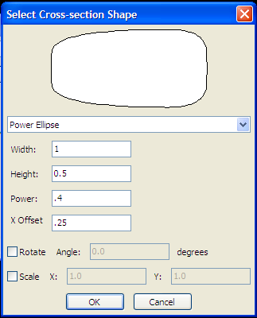
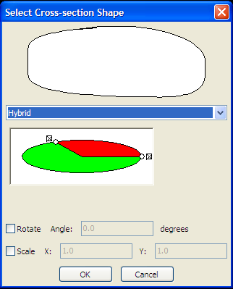
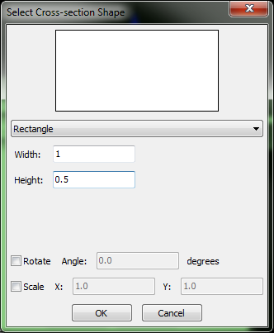
Yarn Cross-Sections – Section Specification
Cross-sections are specified at the locations given by the section interpolation
Available cross-sections:
Ellipse
Lenticular
Power ellipse
Hybrid
Rectangle
Use rather than power ellipse with power = 0 to generate uniform section meshes
Polygon
Only by scripting

Slide 10
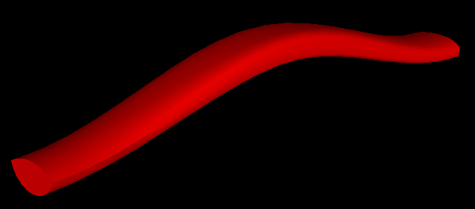
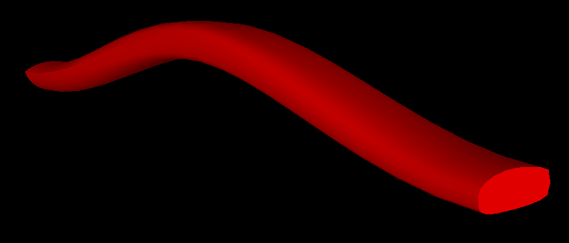
Yarn Cross-Sections – Python Implementation
Python:
YarnSections = CYarnSectionInterpNode()
YarnSections.AddSection( CSectionLenticular(1.0,0.5,0.1) )
YarnSections.AddSection( CSectionPowerEllipse(1.0,0.5,0.4,0.25) )
# Hybrid Section
Top = CSectionEllipse( 1.0, 0.4 )
Bottom = CSectionPowerEllipse( 1.0, 0.4, 0.4, 0.25 )
YarnSections.AddSection( CSectionHybrid( Top, Bottom ) )
Yarn.AssignSection( YarnSections )
Textile.AddYarn(Yarn)

Slide 11
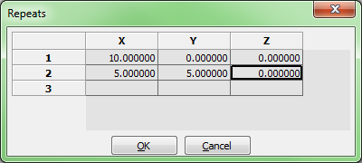
Yarn Repeats
Yarn repeats allow a given yarn section to be repeated as specified by a set of vectors (in theory, allowing an infinite textile)
GUI: Select Modeller -> Assign Repeats
Specify a set of repeat vectors
Python:
Yarn.AddRepeat(XYZ(10,0,0))
Yarn.AddRepeat(XYZ(5,5,0))

Slide 12
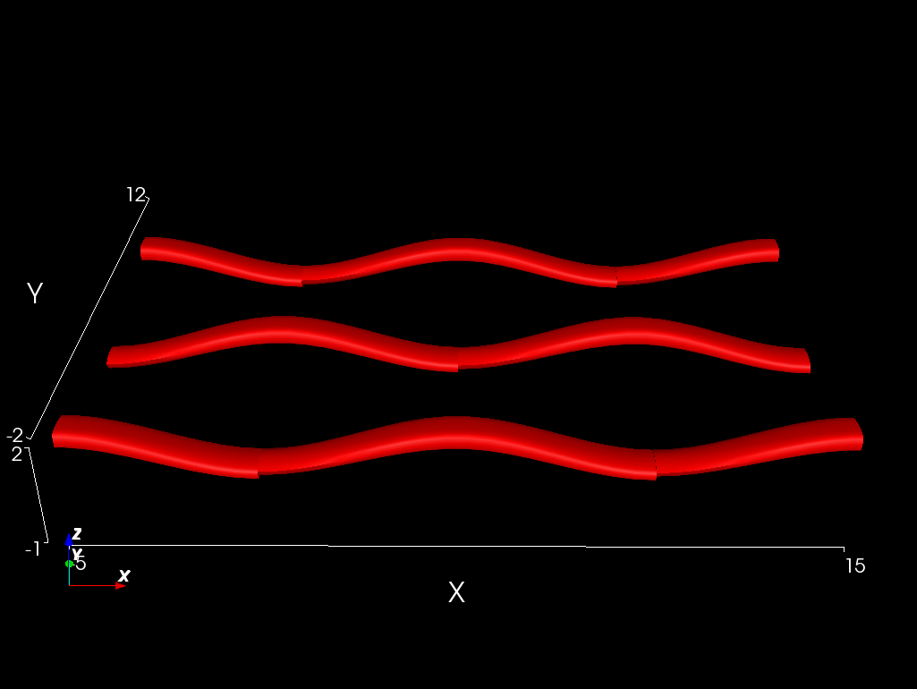
Domain
The domain restricts the model to a specific region
Specified by a set of convex planes
Typically, but not always, the unit cell
GUI:
Select Domain -> Create Box
Input minimum and maximum x,y,z values for bounding box
Or
Select Domain -> Create Planes
Input required number of planes specified by the unit normal to the plane and its distance from the origin
Python:
Textile.AssignDomain(CDomainPlanes(XYZ(-5,-2,-1),XYZ(15,12,2)))
AddTextile(“Workshop”, Textile)

